Slide 1
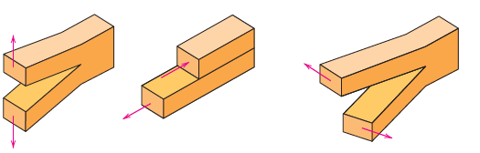
Crack propagation modes
Mode I, tensile stress normal to crack surface
Mode II, shear stress normal to crack surface
Mode III, shear stress parallel to crack leading edge
Toughness corresponding to each crack propagation mode is different
A combination of three modes observed in general case
Mode I is most common and this will be the focus of further discussion

Slide 2

Fracture toughness
Defined as the resistance to brittle fracture in a material containing cracks.
$$K_{c}=Yσ_{c}\sqrt{πa}$$
σ_{c} = Critical stress for crack propagation
a = Crack length
Y = Dimensionless constant with value almost unity
K_{c} = Fracture toughness
Fracture toughness has a unit of MPa√m
For relatively thin specimens, fracture toughness is a function of material thickness and generally increases with thickness.

Slide 3
Fracture toughness
The fracture toughness value for thick specimens (under plain strain conditions) is constant.
K_{Ic}, defined as the plane strain fracture toughness for Mode I loading, is a material constant and is most commonly cited as the fracture toughness of a material
Factors affecting K_{ic}
K_{IC} ⬇ as Temperatur ⬇ and strain rate ⬆
Within a class of alloys, K_{Ic} ⬇ as yield strength ⬆
As grain size of a material ⬇, K_{Ic} ⬆

Slide 4
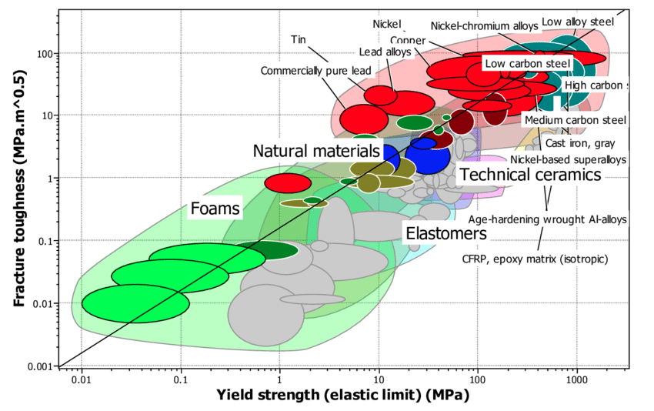
Fracture toughness & material class
Material design aims for both high yield strength and high fracture toughness

Slide 5
Fracture toughness & material class
Fracture toughness of ceramics are rather low, they are inherently brittle

Slide 6
Fracture toughness & material class
Metals have high fracture toughness

Slide 7
Fracture toughness & material class
Steels have both high toughness and high yield strength ➔ reason behind their widespread use as structural material

Slide 8
Fracture mechanics design philosophy
Design presupposes that cracks are present in the structure
The size of the cracks needs to be estimated
The largest crack that may be present is taken as that crack size that is not detected by Non-Destructive Testing (NDT) e.g.
- ultrasonic testing (UT)
- Magnetic testing (MT)
- X-ray imaging (RT)
- Computer tomography (CT)
Using fracture toughness definition, the fracture strength is determined based on this crack length ➔ the operating stress must be less than this stress

Slide 9
Fracture mechanics design philosophy

Slide 10
Impact testing
Prior to the advent of fracture mechanics, impact testing was the preferred testing method.
Fracture toughness testing
Relatively new method
Results are more quantitative
Test equipment, sample preparation and testing are expensive
Impact testing
Much older method and is still widely used
Mainly qualitative
Rather inexpensive method of testing

Slide 11
Impact testing
This test assesses the tendency of a material to brittle fracture
Very severe test conditions for fracture:
Deformations upto very low temperatures
Loading at very high strain rates
Introduction of a tri-axial stress state by introducing a notch
Two standardized tests are employed:
Charpy V-notch (CVN) test
Izod test
Charpy test is the preferred test method and this will be discussed in this course

Slide 12
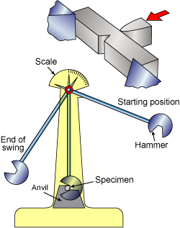
Charpy V-notch (CVN) testing
Specimen is a bar of square cross-section with a machined V-notch
Load is applied as impact from a weighted pendulum hammer released from a height h
After striking and breaking the sample at the notch the hammer continues its swing to a reduced heigh h‘
Energy difference measured from height difference is the Impact energy
h
h‘

Slide 13
Ductile to brittle transition
Many steels show a typical transition from ductile failure (at high temperatures) to brittle failure (at low temperatures)
CVN is ideally suited to determine this ductile to brittle transition
Impact testing is carried out for a steel over a range of temperatures
Ductile behavior: At high temperatures with relatively high energy absorption
Brittle behavior: At low temperatures with relatively low energy absorption

Slide 14
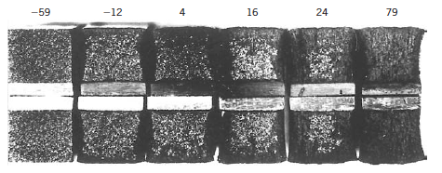
Ductile to brittle transition
Appearance of the fracture surface tested at different temperatures qualitatively capture the transition from ductile to brittle behavior:
Ductile behavior: the surface appearance is fibrous / dull
Brittle behavior: the surface appearance is granular / shiny
Brittle
Ductile

Slide 15
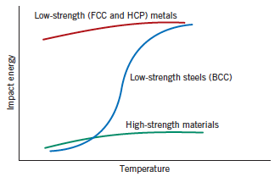
Transition curve for different metals

Slide 16
Transition curve for different metals
Low strength FCC (like Al and Cu) and most HCP metals do not show the transition and have high impact energy (i.e. they remain tough) even at low temperatures
High strength materials (like high strength steels) do not show the transition and have low impact energy (i.e. they are brittle) even at high temperatures
Low strength steels with bcc structure characteristically show the ductile to brittle transition

Slide 17
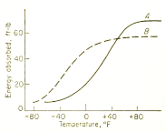
Material selection & transition curve
Steel A shows higher notch toughness at high T
However, ductile to brittle transtition in steel A occurs at higher T
Steel B is preferred when use over complete T range is considered

Slide 18
Ductile-Brittle Transition Temperature
Several definitions of DBTT are available:
Temperature at which CVN-energy is 20 J or 15 ft-lb
Temperature at which fracture surface is 50% fibrous
Temperature coresponding to 50% of max. energy

Slide 19
Lecture 3

Slide 20
Fatigue
It is a form of a failure in which a structure subjected to alternating stresses fail at stress levels considerably lower than the stresses necessary for failure under static loading
This is the most common route of structural failure in metallic materials
In order for fatigue failure, at least some portion of the stress cycle must be tensile in nature
Even in very ductile materials, the fatigue failure is brittlelike in nature – very little plastic deformation
Ordinarily the fracture surface is normal to the direction of applied stress

Slide 21
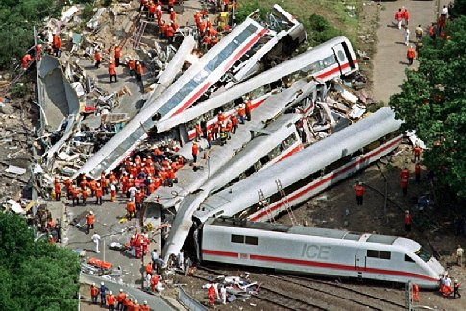
Some examples of fatigue failure
Accident killing > 100 people in Germany in 1998 due to failure caused by a single fatigue crack in a wheel

Slide 22
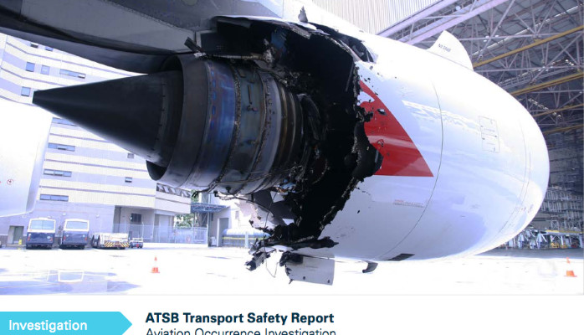
Some examples of fatigue failure
Emergency landing of Qantas flight 32 in 2010 due to engine damage by fatigue cracking of misaligned engine parts

Slide 23
Parameters important to fatigue
If for each stress cycle, the maximum and minimum stress are σ_{max} and σ_{min}, respectively
Mean stress (σ_{m}):
Range of stress (σ_{r}):
Stress amplitude (σ_{a}):
Stress ratio (R):

Slide 24
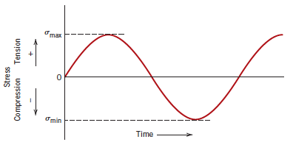
Typical fatigue stress cycles
Reversed stress cycle: Cycle is symmetrical about zero mean stress. Alternating between max. tensile stress and min. compressive stress of equal magnitude

Slide 25
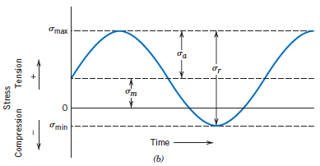
Typical fatigue stress cycles
Repeated stress cycle: Maximum and minimum of stress are asymmetrical relative to the zero stress level.

Slide 26
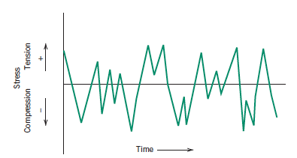
Typical fatigue stress cycles
Random stress cycle: Both maximum and minimum stresses vary randomly

Slide 27
Fatigue test
The applied stress may be tension-compression, bending or torsional in nature
A series of tests need to be performed
The first test is carried out at a high stress, where failure in a relatively short number of cycles is expected
For each succeeding specimen the test stress is decreased until few samples do not fail
Data are plotted as stress S (typically alternating stress σ_{a}) vs. logarithm of number of samples N ➔ S-N curve

Slide 28
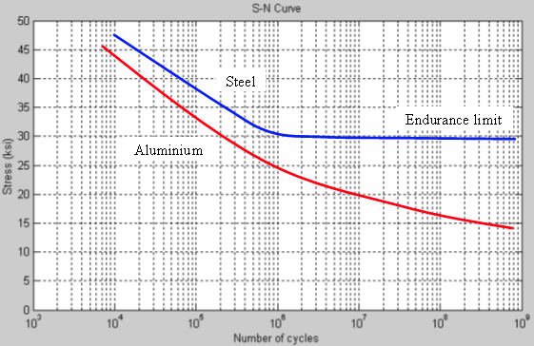
S-N curve

Slide 29
S-N curve
Typically for steels, the S-N curve becomes horizontal at a certain limiting alternating stress, known as fatigue limit or endurance limit.
Below fatigue limit the material can withstand infinite number of samples without failure.
S-N curves of most non-ferrous metals like Al, Cu show no fatigue limit
For these materials stress at certain number of cycles (e.g. 10⁸ cycles) is taken as fatigue limit.
Low cycle fatigue: Number of cycles to failure typically < 10⁵
High cycle fatigue: Number of cycles to failure typically > 10⁵

Slide 30
Propagation of fatigue damage
3 steps of fatigue failure
Crack initiation
Crack propagation
Final failure
Fatigue cracks almost always initiate on the surface of a component at some stress concentration. These include
Surface scratches
Sharp fillets
Threads, dents etc.

Slide 31
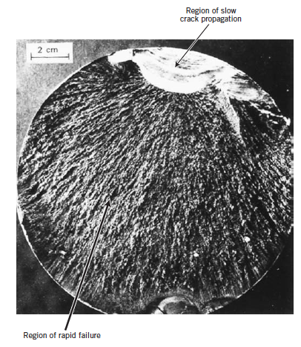
Propagation of fatigue damage

Slide 32
Propagation of fatigue damage
Beachmarks and striations, which appear as concentric ridges and expand away from the crack initiation site in circular or semicircular pattern are telltale features of fatigue failure.
The fracture surface typically consists of a smooth region and a rough region
Smooth areas correspond to regions where crack propagation is slow

Slide 33
Factors affecting fatigue life
Mean stress
Increasing the mean stress leads to a reduction of fatigue life. The effect of mean stress on fatigue limit is typically plotted in Goodman plot.
Stress concentrations
Presence of stress raisers such as notches and/or holes seriously reduce the fatigue life. Careful design of components to remove stress raisers is necessary to minimize fatigue.

Slide 34
Factors affecting fatigue life
Size of component
Generally the fatigue strength of large components is smaller than the small components.
Effect of surface
As fatigue cracks often are generated at the surface, fatigue life is strongly dependent on surface conditions:
Smoothly polished surfaces normally have a higher fatigue life
Hardfacing techniques like carburizing significantly improves the fatigue life
Introduction of compressive residual stresses at the surface (e.g. by shot peening) is very effective in enhancing fatigue life.

Slide 35
Factors affecting fatigue life
Corrosion fatigue
Failure occurring by the simultaneous action of a fluctuating stress and corrosive environment is called corrosion fatigue. Fatigue life is decreased in the presence of corrosive environment.
Thermal fatigue
Fluctuating thermal stresses generated from restraints to dimensional changes of components resulting from temperature vibrations may cause fatigue damage of a component even in the absence of mechanical stresses.
Select materials with lower thermal expansion coefficient
Change design to allow unhindered dimensional change

